Slide 1

Google File System —— 陶一丁 黄文政

Slide 2

Introduction
What is GFS?
Scalable distributed file system
for large distributed data-intensive applications
Runs on inexpensive commodity hardware
Fault tolerance
aggregate performance
Notes:
GFS是一个可扩展的分布式文件系统，用于大型的、分布式的、对大量数据进行访问的应用。它运行于廉价的普通硬件上，并提供容错功能。它可以给大量的用户提供总体性能较高的服务。

Slide 3
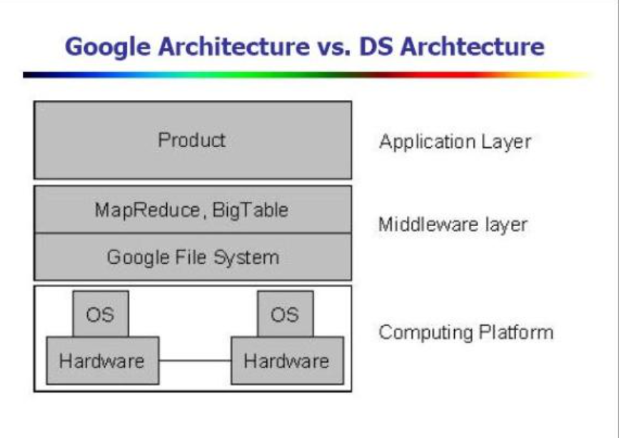
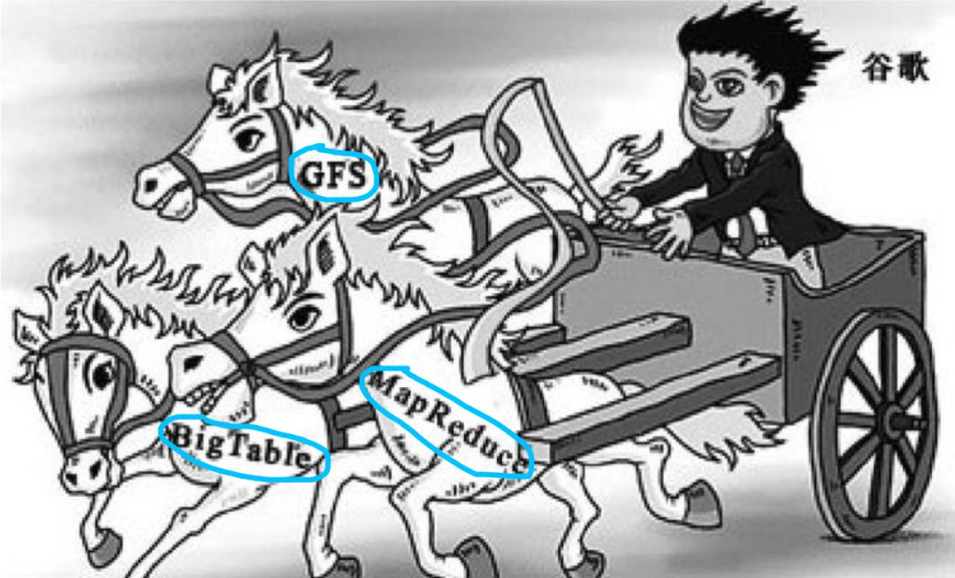
Introduction
Importance
The most important technology for Google to dominate the world search engine market
cornerstone of google distributed storage(big table, megastore, and percolator)
The originator of big data analysis: Google FS, MapReduce, Big Table
Notes:
谷歌之所以现在能称霸世界搜索引擎市场，最重要的技术就是GFS，GFS是google分布式存储的基石，其他存储系统，比如Google的big table、megastore、均直接或者间接的构建在GFS上。Google File System那么被人称道的原因就是它是Google集群技术的核心。
google的三驾马车：Google FS、MapReduce、Big Table
这三个产品的详细设计论文，奠定了风靡全球的大数据算法的基础！

Slide 4
Introduction
Why GFS?
High performance
High reliability
High availability
Special design for Google
Notes:
与传统的分布式系统相比，在大方向上，GFS 同样追求高性能、高可靠性、高可用性，同时 Google 基于自身的生产环境、技术环境，有一些特殊的设计思路。

Slide 5
Design Concept
Component failure → normal! exception
Files → HUUUUGE!
Appending new data >> overwriting existing data.
Co-designing the applications & the file system API
→ Flexibility
Notes:
首先，组件失效被认为是常态事件，而不是意外事件。廉价的硬件 被大量的客户机访问 所以，持续的监控、错误侦测、灾难冗余以及自动恢复的机制必须集成在GFS中。
其次，以通常的标准衡量，我们的文件非常巨大。块的大小必须要重新考虑
第三，绝大部分文件的修改是采用在文件尾部追加数据，而不是覆盖原有数据的方式。一旦写完之后，对文 件的操作就只有读，而且通常是按顺序读
在一个文件中随机的操作在实践中几乎不存在。对大量数据的流方式的读操作和 少量数据的随机方式的读操作。
第四，应用程序和文件系统API的协同设计提高了整个系统的灵活性。

Slide 6
How to store a normal file? (in your PC)
Disk
Blocks
Block 23
Block 24
Block 25
…
Metadata
File info
File name
Size
…
Index
Block 23>>disk offset
Block 24>>disk offset
Block 25>>disk offset
1 Block = 1024byte

Slide 7
How to store a big file?
Disk
Chunk
Chunk 23
Chunk 24
Chunk 25
…
Metadata
File info
File name
Size
…
Index
chunk 23>>disk offset
chunk 24>>disk offset
chunk 25>>disk offset
1 chunk = 64MB
= 65,536 blocks

Slide 8
How to store a super big file? (1 Computer cannot hold)
Master
Metadata
File info
…
Index
chunk 1>>disk offset
chunk 2>>disk offset
chunk 3>>disk offset
chunk 4>>disk offset
chunk 5>>disk offset
chunk 6>>disk offset
…
Chunkserver 3
Chunk 1
Chunk 2
Chunk 3
…
Chunkserver 5
Chunk 4
Chunk 5
Chunk 6
…

Slide 9
About using Master +ChunkServers
A problem that would cause significant amount of data flow:
Any change in chunkserver
must
inform The mater!
e.g. the change of disk offset

Slide 10
How to store a super big file? (further improve)
Master
Metadata
File info
…
Index
chunk 1>>CS3
chunk 2>>CS3
chunk 3>>CS3
chunk 4>>CS5
chunk 5>>CS5
chunk 6>>CS5
…
Chunkserver 3
index
Chunk1>>disk offset
Chunk2>>disk offset
Chunk3>>disk offset
Chunk 1
Chunk 2
Chunk 3
…
Chunkserver 5
index
Chunk4>>disk offset
Chunk5>>disk offset
Chunk6>>disk offset
Chunk 4
Chunk 5
Chunk 6
…

Slide 11
About using Master +Chunkservers
Point: Master doesn’t record disk offset High cohesion & Low coupling
It reduces the metadata of master
And the frequency of communication between master and chunk servers.
How to detect data damage?

Slide 12
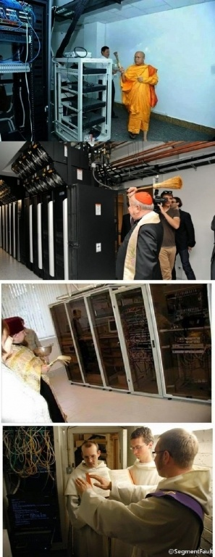
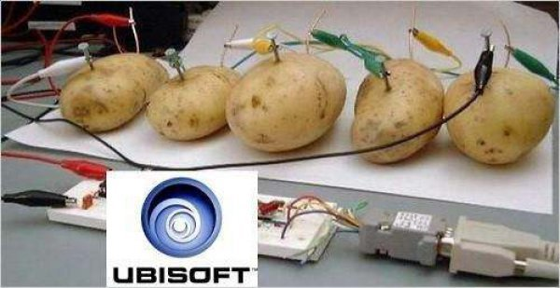
What if chunk or even chunk server broke down?

Slide 13

What if chunk or even chunk server is broken?
Solution:
Copy a chunk Three times and store them in three different chunk servers.

Slide 14
How to repair broken chunk?
Master
Chunk 3 >> CS3, CS5, CS4
My chunk3 is broken, who else has it?
Chunk Server 5
Chunk 10
Chunk 7
Chunk 3
Chunk Server 3
Chunk 10
Chunk 7
Chunk 3
Ask CS3, CS5!
Chunk Server 4
Chunk 1
Chunk 2
Chunk 3
Give me Chunk3
Give you

Slide 15
How to detect a chunk server fail?
Master
CS1>>20200312_1520
CS2>>20200312_1521
CS3>>20200312_1515
CS4>>20200312_1523
Heart Beat
I’m alive!
I’m alive!
I’m alive!
CS1
CS2
CS3
CS4
Notes:
How to detect a chunk server fail?
Each CS will regularly tell Master its status.
For example, CS1 says "I'm alive" to Master and master will record the report time. CS2 also says "I'm alive" to Master and master records the time. The same to CS4. But CS3 has been silent for long time since its last report. So It will be judged to be dead. This mechanism is just like heart beat. If a chunk server doesn't make heart beat for long time then Master will think it is dead.

Slide 16
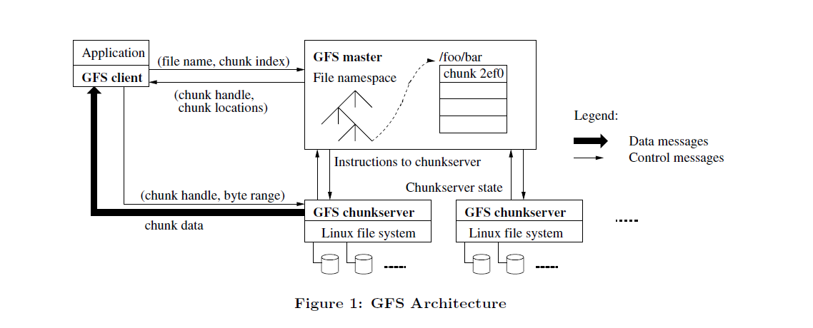
How to read?
Ghemawat S , Gobioff H , Leung S T . The Google file system[J]. ACM SIGOPS Operating Systems Review, 2003, 37(5):29.

Slide 17
How to Write?
1. Where is the chunk XX
4. Synchronize!
Client
Master
2. Return replica list
3. Send data. Stored in LRU buffer cache.
Secondary
Replica A
CS0
6. Complete
7. Complete
Primary
Replica
CS3
5. Signal(write into disk)
Secondary
Replica B
CS5

Slide 18

THANK YOU

